Slide 1
Web Development

Slide 2
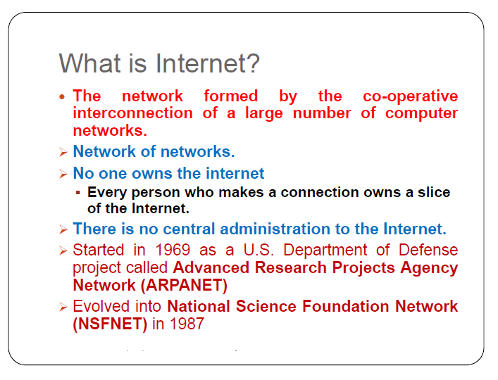
INTERNET

Slide 3
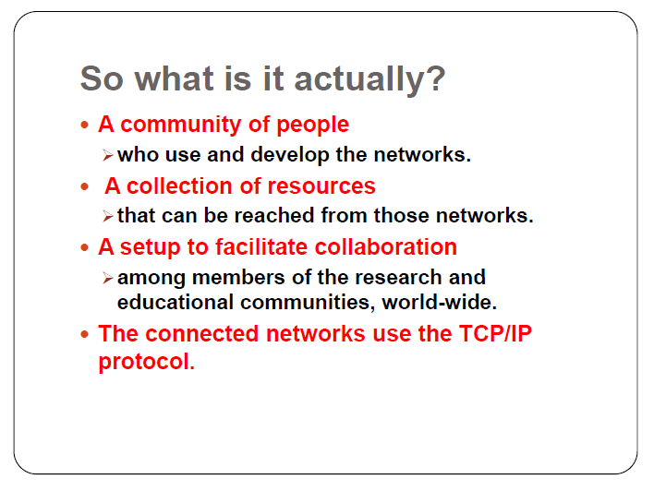
NETWORK COMMUNICATION

Slide 4
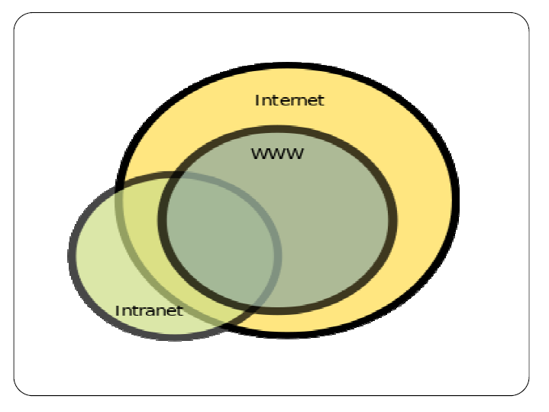
TYPES OF NETWORK

Slide 5
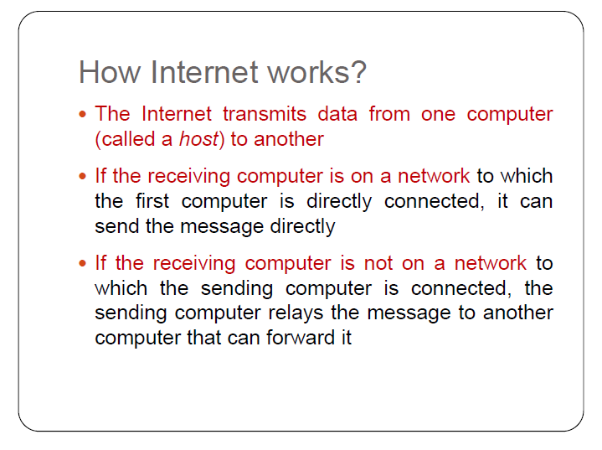
HOW INTERNET WORKS

Slide 6
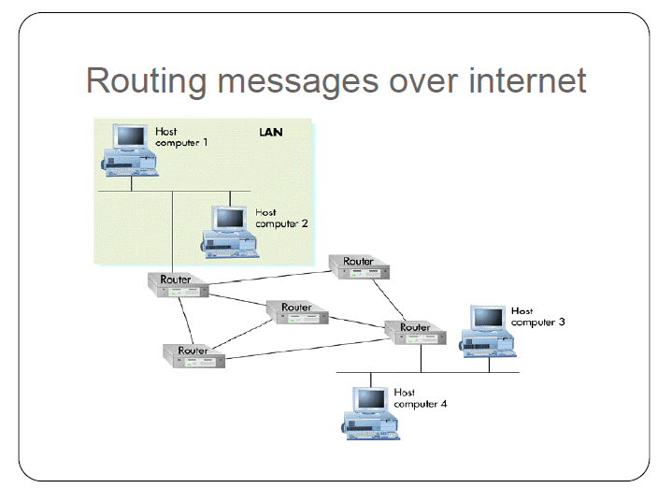
Routing messages over internet

Slide 7
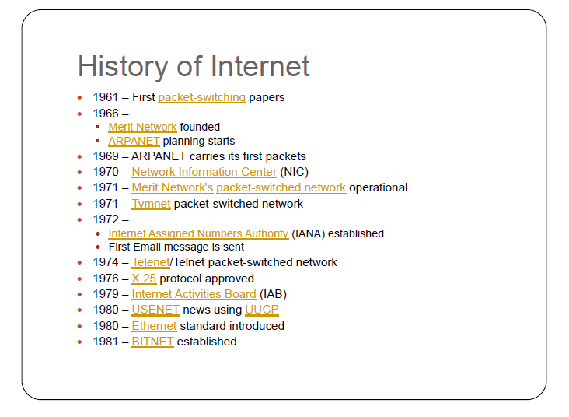
History of Internet

Slide 8
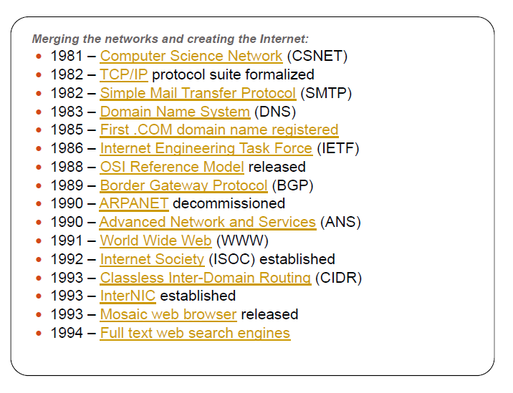
History of internet

Slide 9
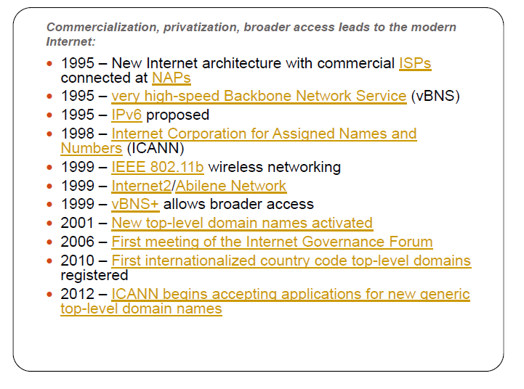
History of internet

Slide 10
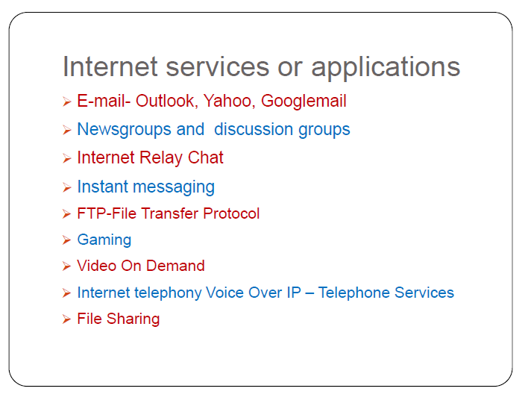
Internet services

Slide 11
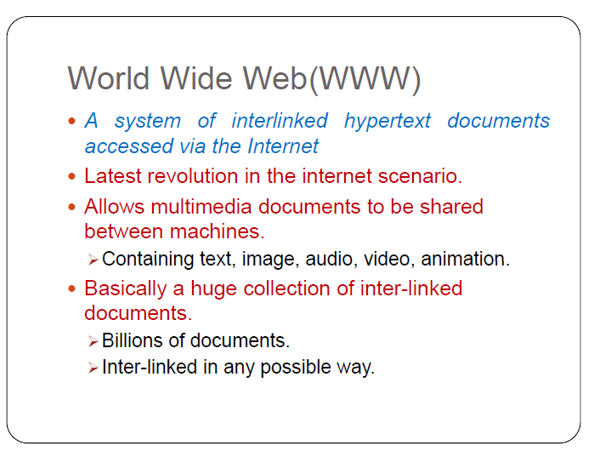
www

Slide 12
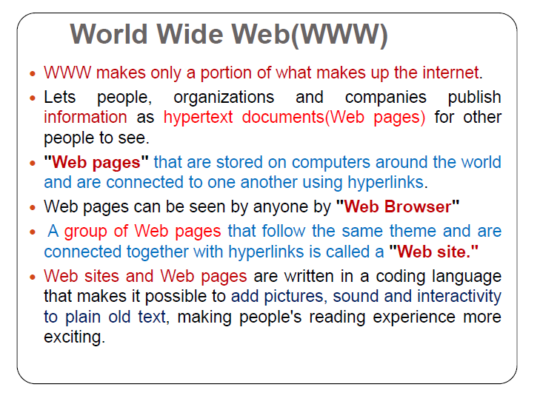
www

Slide 13
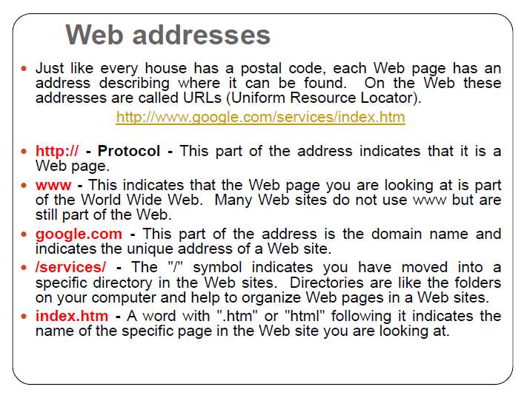

Slide 14
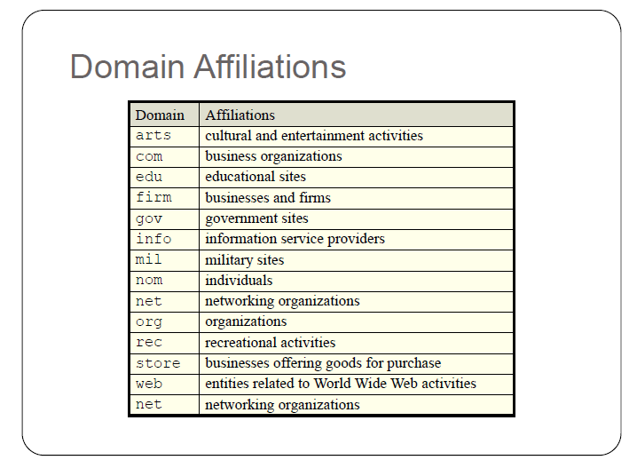

Slide 15
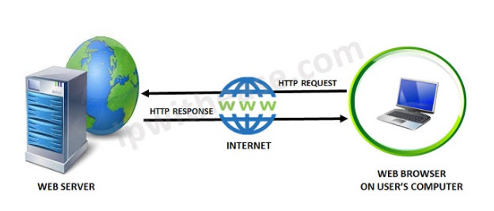
What is Web?
The Web is the common name for the World Wide Web (WWW)
The Web is just one of the ways that information is shared over the Internet.
The Web consisting of the pages that can be accessed by a Web browser such as Internet Explorer, Google Chrome, Mozilla Firefox
Web pages are formatted in a language called HTML.
The Web uses HTTP protocol to transmit data and share information.

Slide 16
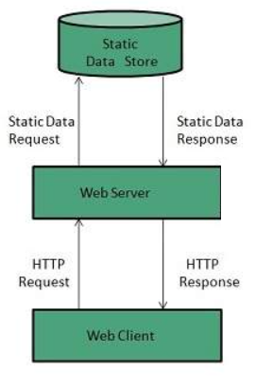
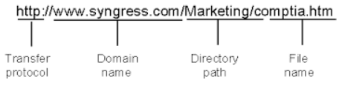
What is Web Server?
Web server is a computer where the web content is stored
Web server is used to host the web sites
When client sends request for a web page, the web server search for the requested page if requested page is found then it will send it to client with an HTTP response.

Slide 17
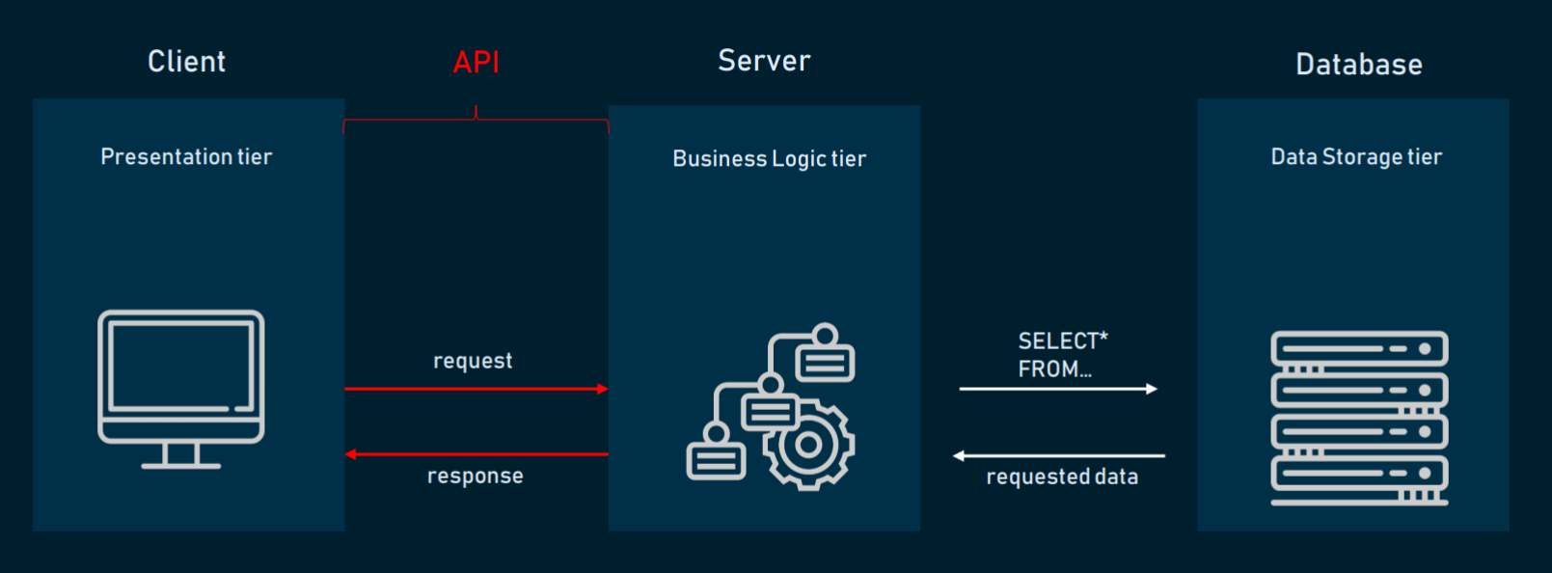
Application Architecture
HTML, CSS, JavaScript, Reactjs

Slide 18
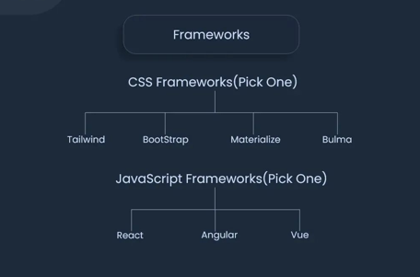
FRONTEND FRAMEWORKS

Slide 19
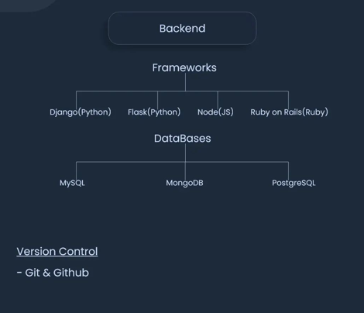
BACKEND FRAMEWORKS

Slide 20
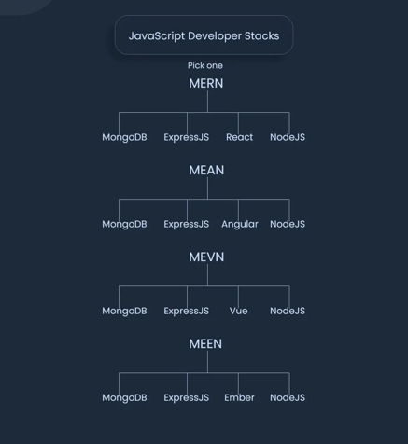
JAVASCRIPT FRAMEWORKS

Slide 21
What is HTML?
HTML (HyperText Markup Language) is the most basic building block of the Web.
HTML describes the structure of a Web page.
HTML consists of a series of elements.
HTML elements tell the browser how to display the content.
HTML elements are represented by tags.
HTML tags label pieces of content such as "heading", "paragraph", "table", and so on.
Browsers do not display the HTML tags, but use them to render the content of the page

Slide 22
What is Hypertext & Markup?
Hypertext is a text which references to other text.
Hypertext means machine readable text and Markup means to structure it in a specific format.
So, HTML is called hypertext markup language because it is a language that allows users to organize, improve the appearance of, and link text with data on the internet.

Slide 23
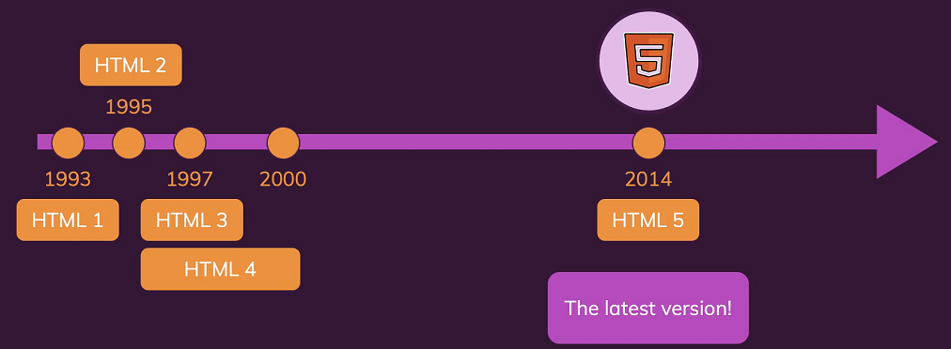
History of HTML

Slide 24
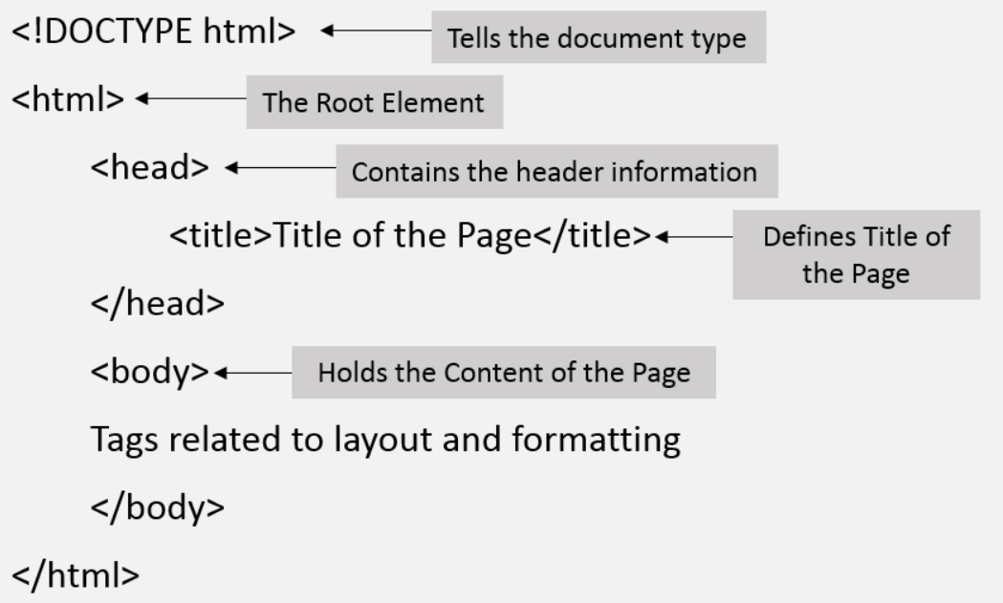
Structure of HTML

Slide 25
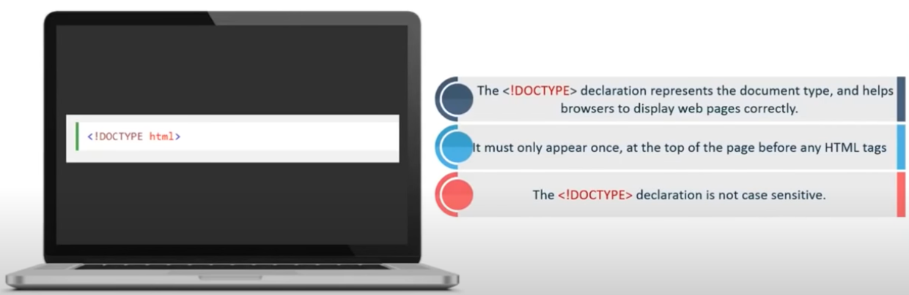
<!Doctype html> Declaration

Slide 26
Structure of HTML continue..
The Head Element
The <head> element is a container for metadata and is placed between the <html> tag and the <body> tag.
HTML metadata is data about the HTML document.
Metadata typically define the document title, character set, styles, scripts, and other meta information.
The <title> Element
The <title> element defines the title of the document.
Defines a title in the browser toolbar
Provides a title for the page when it is added to favorites
Displays a title for the page in search engine-results

Slide 27
HTML Body Tags
Heading Tags - <h1>, <h2>, <h3>, <h4>, <h5>, <h6> tags.
Paragraph Tag - <p> tag.
Horizontal ruler - <hr> tag.
Anchor(Link) Tag - <a> (anchor) tag.
List Tag - <ul> (unordered list), <ol> (ordered list) and <li> (list element) tags.
Image Tag - <img> tag
Divider, denoted using the <div> tag
Text span, denoted using the <span> tag

Slide 28
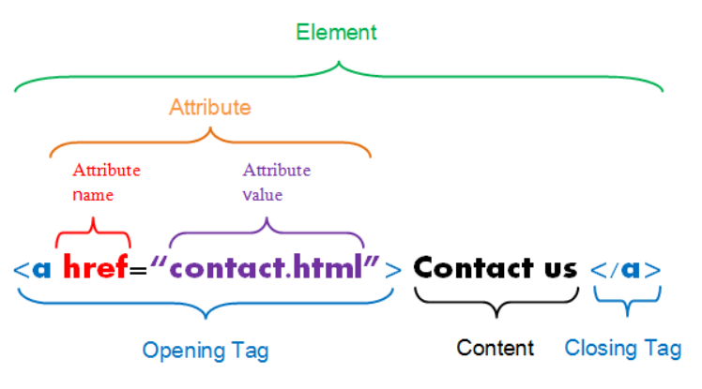
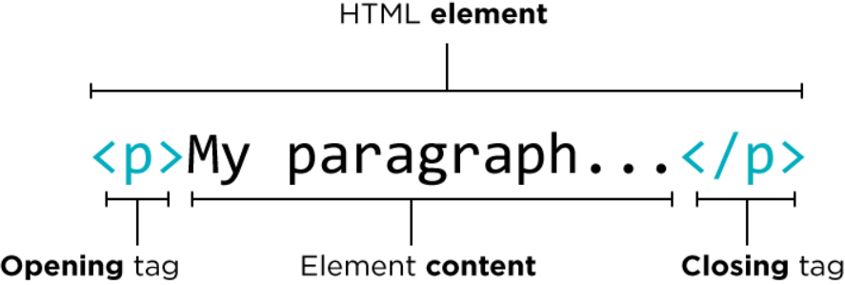
HTML Element, Tag & Attribute

Slide 29
HTML Elements
HTML Headings
HTML headings are defined with the <h1> to <h6> tags.
<h1> defines the most important heading. <h6> defines the least important heading.
HTML Paragraphs
HTML paragraphs are defined with the <p> tag.
<h1>This is heading 1</h1> <h2>This is heading 2</h2> <h3>This is heading 3</h3>
15hrs
<p>This is a paragraph.</p>
<p>This is another paragraph.</p>

Slide 30
HTML Elements continue..
HTML Links
Use the <a> element to define a link
Use the href attribute to define the link address
Use the target attribute to define where to open the linked document
Use the <img> element (inside <a>) to use an image as a link
HTML Images
Use the HTML <img> element to define an image.
Use the HTML src attribute to define the URL of the image.
Use the HTML alt attribute to define an alternate text for an image, if it cannot be displayed.
Use the HTML width and height attributes to define the size of the image
15hrs
<a href="https://www.credosystemz.com">This is a link</a>
<img src="credologo.jpg" alt="credosystemz.com" width="104" height="142">

